Slide 1



Introduction Of Price Anchoring Strategy For Commercial Viability Of A Street Food Business.
Let’s manage the data of the Business.
Authored By: Parashmani Datta
Course-BDM
ROLL-21f2000987

Slide 2

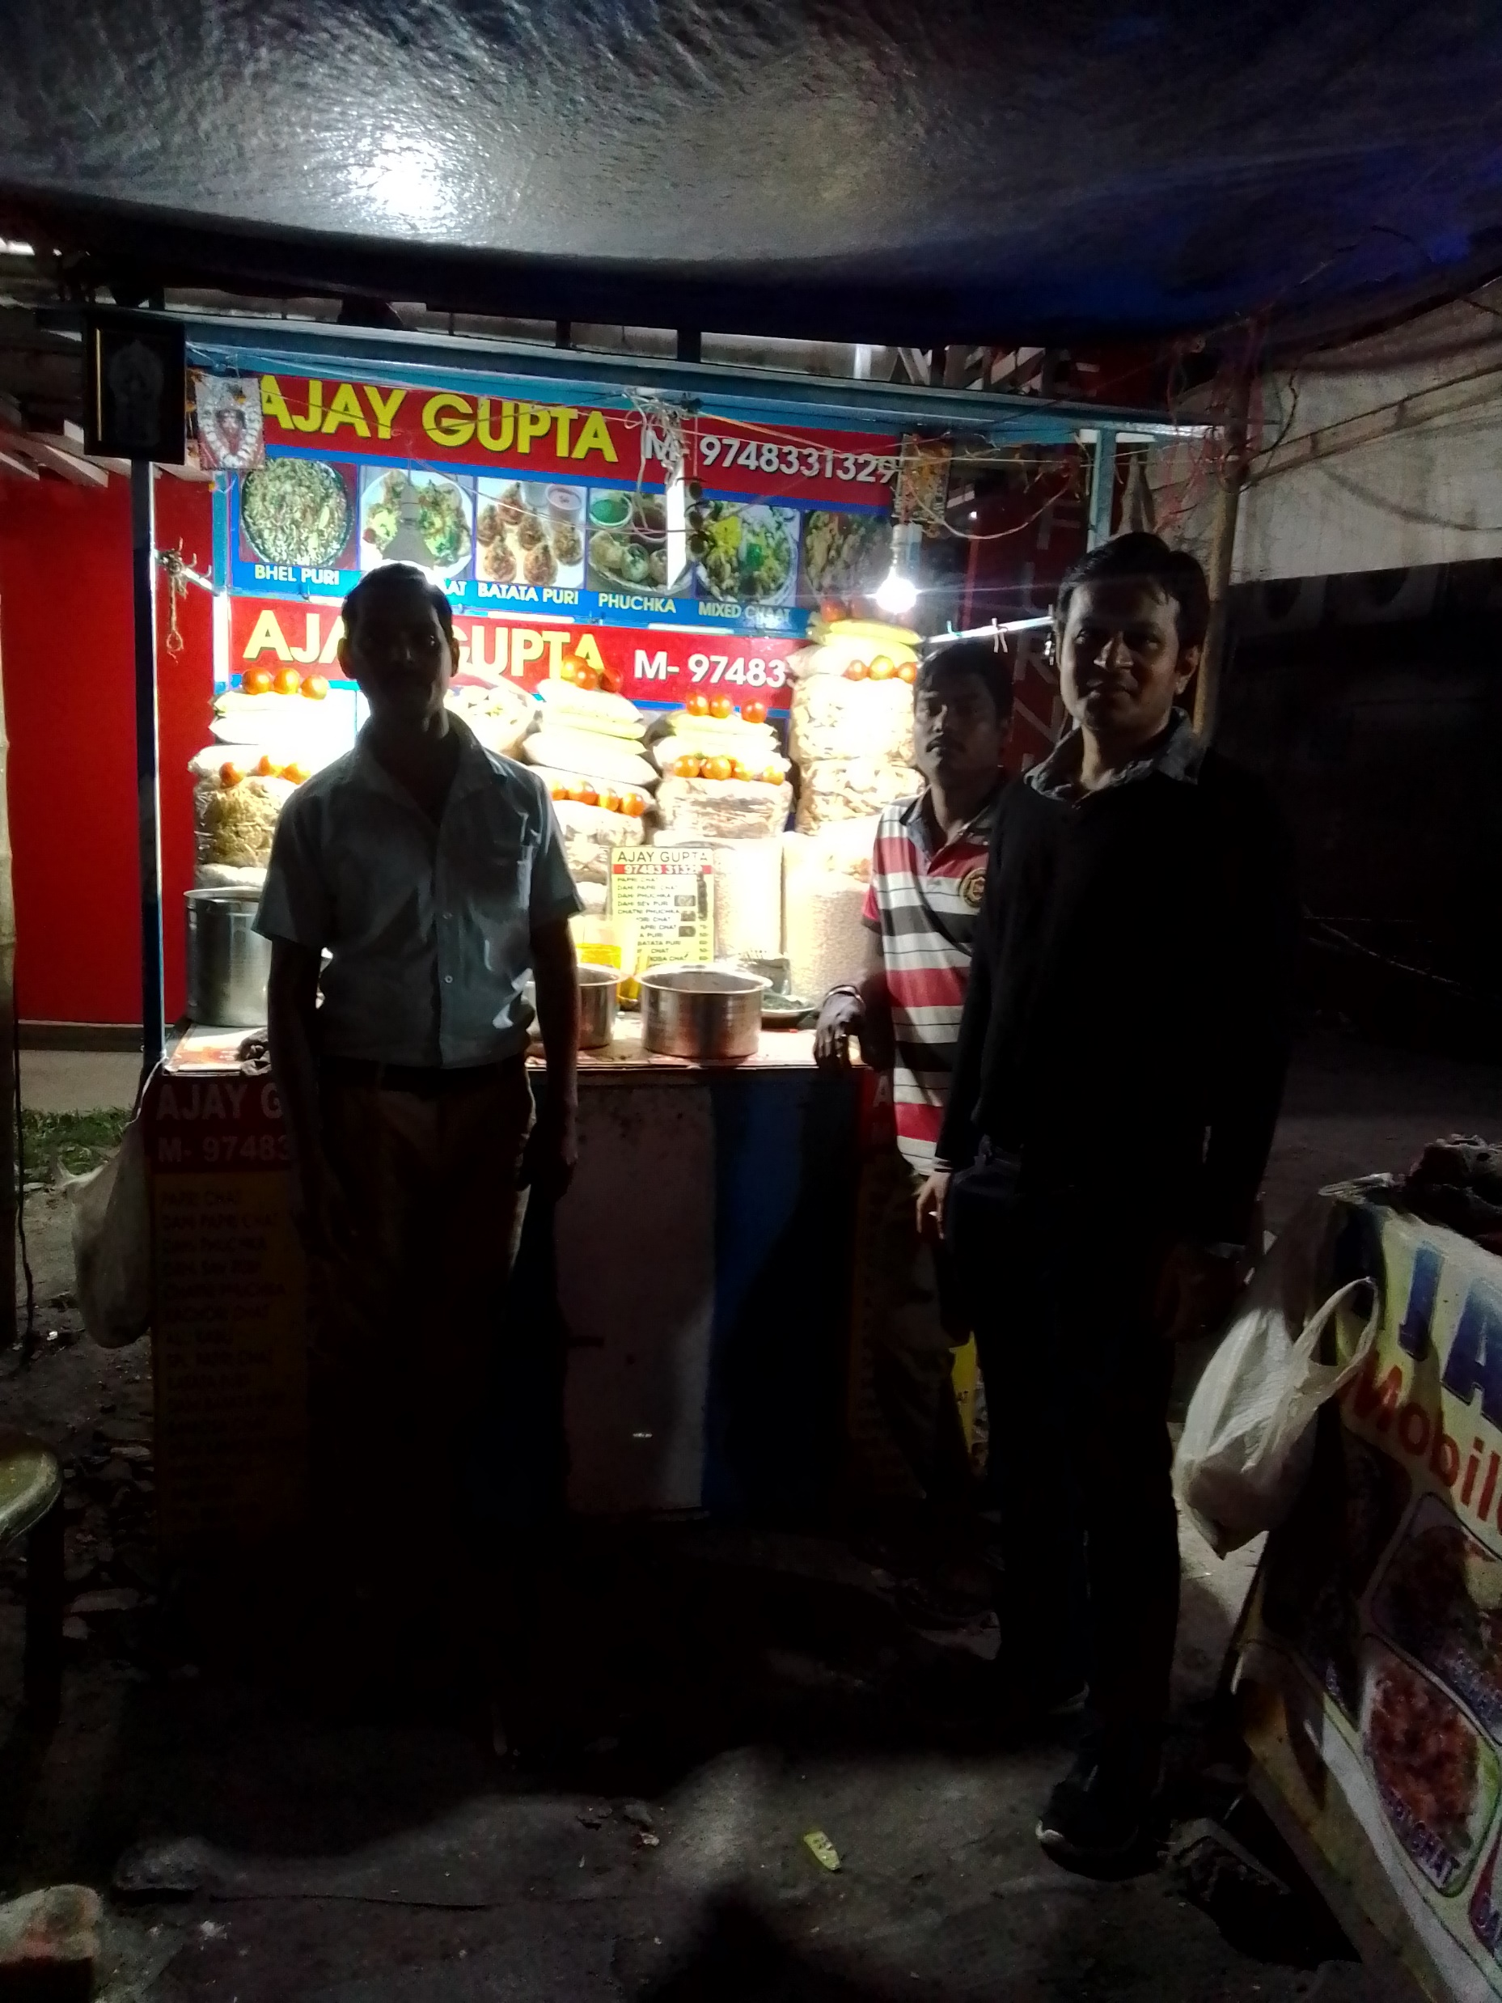
Problem??
Lack of permanent area
2) No pricing strategy
3)Unable to maintain proper hygiene
4) Political offerings resulting in increase of rivalries.

Slide 3
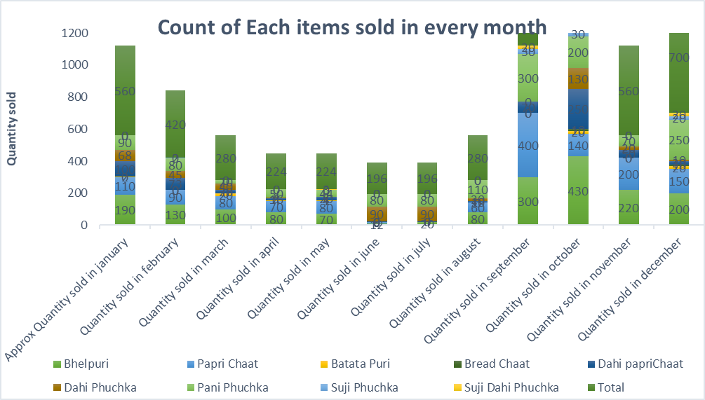
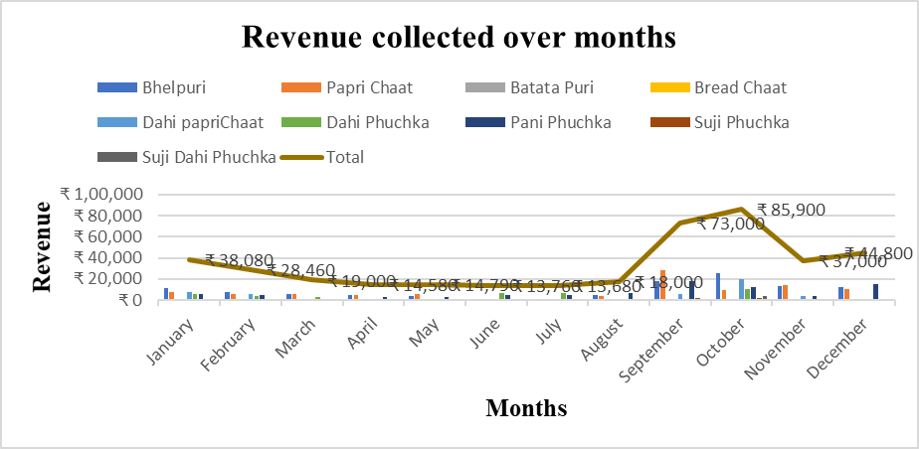
Mr. Ajay sells 6020 items in a year and total revenue collected is INR 401050. Gross profit turns out to be INR226330. Net profit turns around to be INR106330.

Slide 4

Mr. Ajay’s Business. The straight line is his lifeline.
1
2
3

Slide 5


Price Anchoring Strategy
Explanation:-
A cognitive bias where customers depend too heavily on a piece of initial information to make subsequent decisions.
How E-commerce uses Price Anchoring Strategy
During a sale, the sale price is set besides the original price. Thus, the customers came to know what a deal they are getting at what discount.
2. During the off-sale time, they simply list more expensive products just next to cheaper ones. This will draw customers’ attention to both products and encourage more sales.

Slide 6
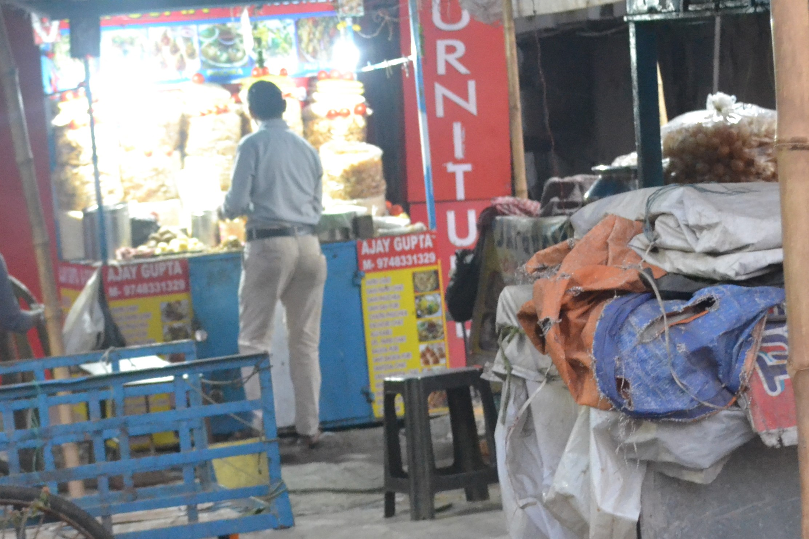
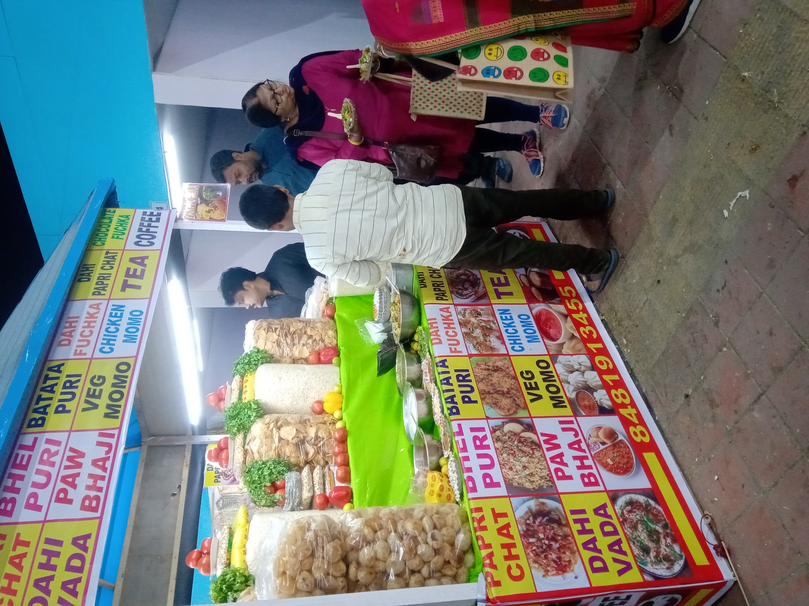
Why Mr. Ajay will use Price Anchoring Strategy?
1. Rival Shops will not be able to compete
2. Fixed customer base will increase
New item will be introduced to differentiate him from rival shops.
4. Customers will get a change of Taste.
Mr. Ajay’s shop
Rival Shop Customers
Before Price Anchoring.
Churn of Customers.

Slide 7
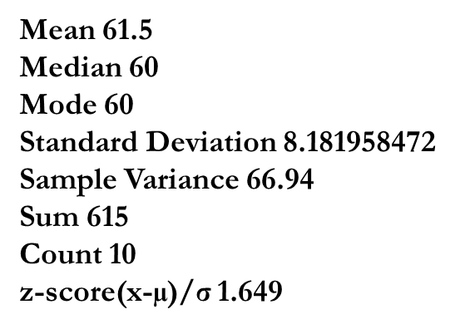
How Mr. Ajay will use Price Anchoring?
Target-1: - To introduce the new item ‘Haldi Muri with safflower’ which is little addition of turmeric in the fried puffed rice and safflower seeds (Kusum Beej in Bengali) that will provide a new look to the item, which will showcase its ayurvedic aspects to the customers because of the turmeric and safflower. The price of this item will be higher than all other items’ price but cost will be equal to that of ‘Bhelpuri’.
Present Statistics of items After addition of 'Haldi Muri'
1) After assuming price of ‘Haldi Muri’ to be INR70
the z0.05=1.645 provide strong evidence to use the strategy.
2) Correlation = 1 . Covariance = 60.25
The Pearson correlation coefficient which indicates
the direction of increase and decrease between 2 variables
shows a positive perfect correlation along with high positive
covariance. These highlights the strong relationship
between the 2 prices so he can increase the level
of systematic risks by introducing the new item in his portfolio.
Mean 70
Median 70
Mode 60
Standard Deviation 8.66
Sample Variance 75
Sum 630
Count 9
z-score(x-µ)/σ 0.57

Slide 8
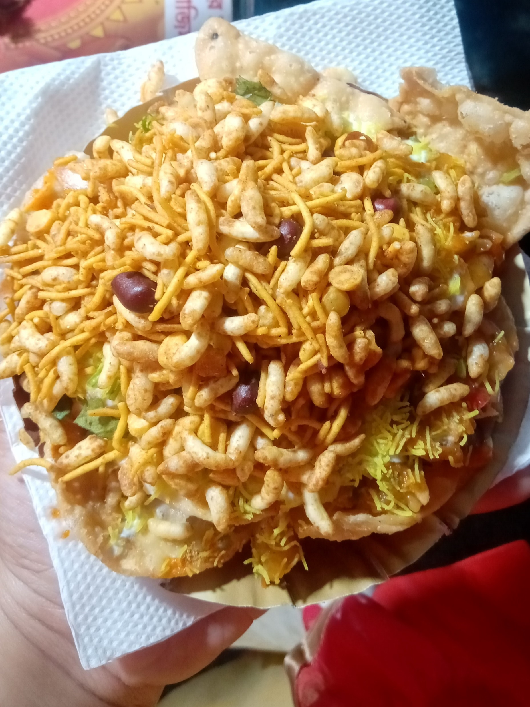
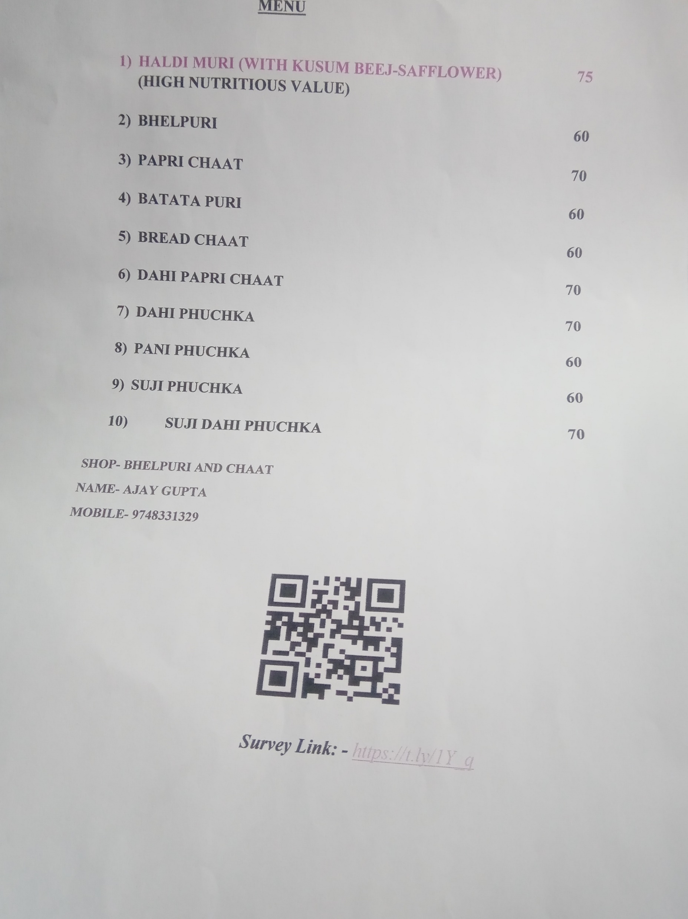
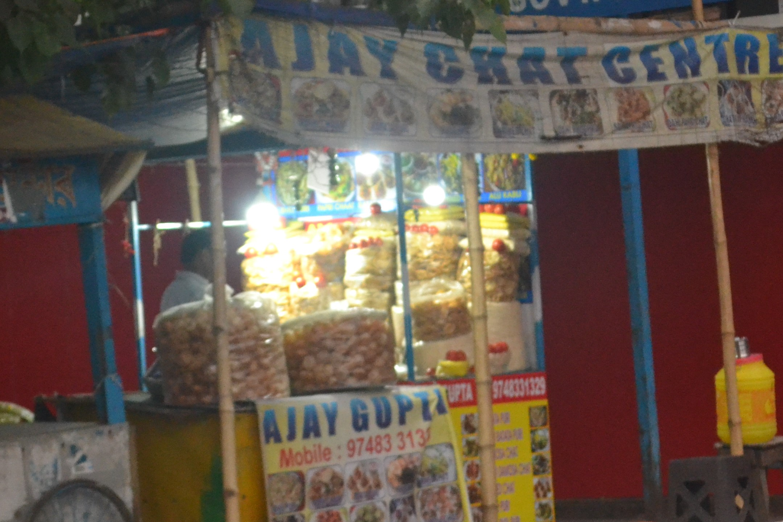

Steps to Introduce Price Anchoring Strategy?
Step 1:- Preparation of new item
Step 2: Preparation of Menu Card with new price
Step 3: Advertisement

Slide 9
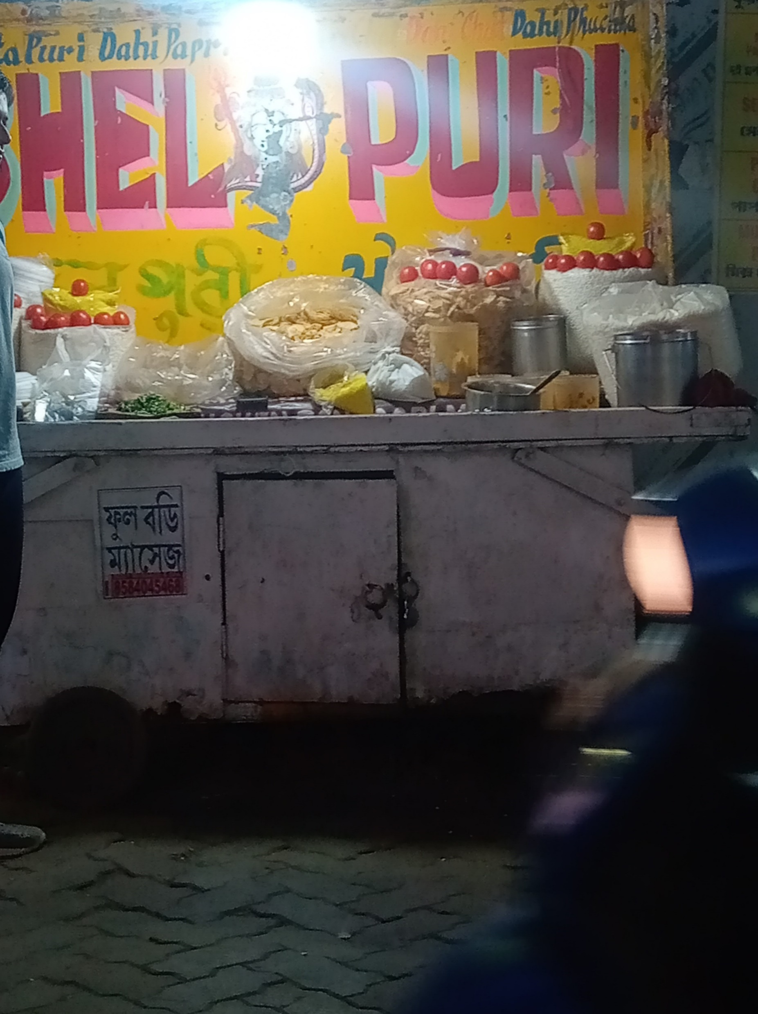
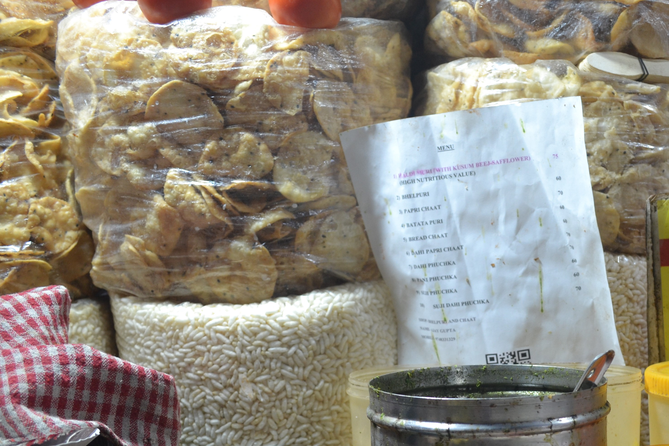
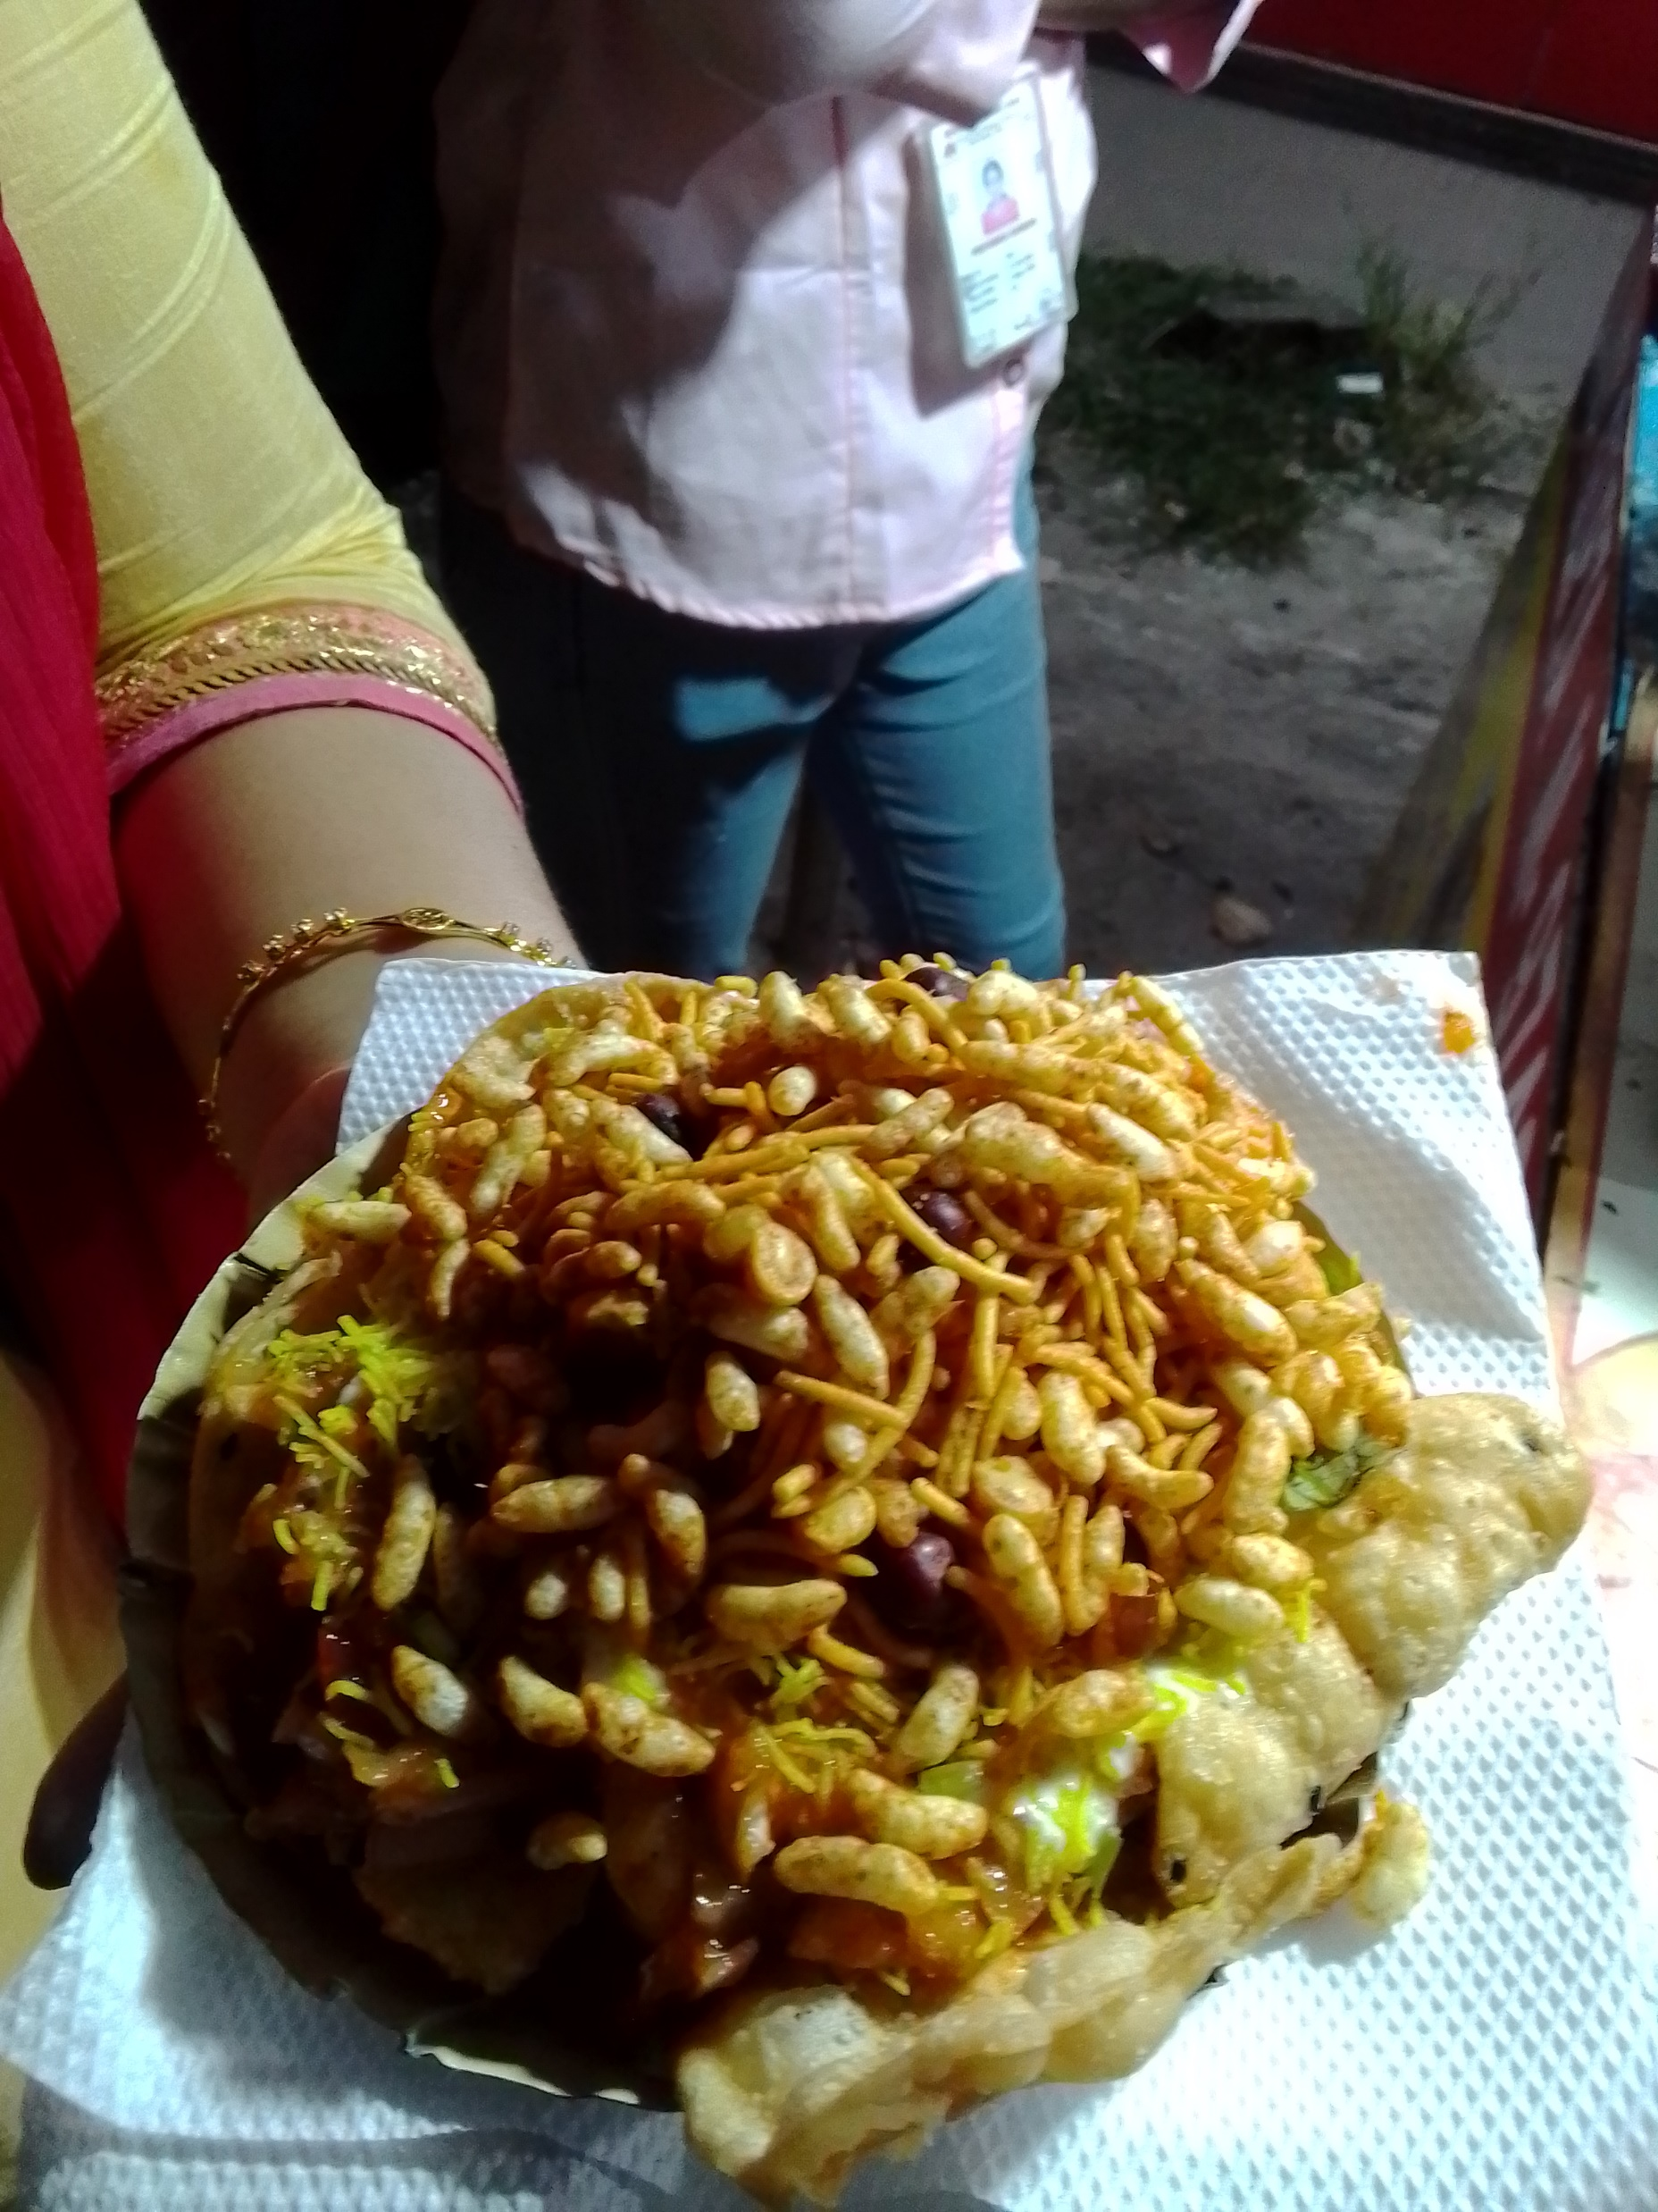




Results After Introduction of Price Anchoring Strategy
Use Of Z-score
to decide the
new price
Before Introduction
of New Item
with Price Anchoring
Addition of new item
In the Menu Card
New item Turmeric Puffed Rice
With Safflower
Customers Base
Increased.
Thus, Mr. Ajay is happy.

Slide 10
Risk or Viability
Now in statistics ‘Risk’ refers to the probability of occurrence of an event or outcome. Therefore, the technique of risk analysis can be used to identify and assess factors that may jeopardize the success of achieving the target.
The greater the Standard deviation the greater the risk. Similarly, without comparing, even if Standard Deviation and risk both are high the business will be at loss with the new strategy.
Total 200 customers | Satisfied with Price | Unsatisfied with Price | Risk
Experimental (Street shop with same price) | 90 | 110 | 0.55
Control(with higher price) | 75 | 125 | 0.63
Relative Risk (Experimental/control) | 0.87
After cohort analysis from the owner, who received feedback from more or less 200 customers, the data reveals that the street shop is at higher risk with higher price. The reason can be the street shop customers fall under bourgeoise or below this group. So, a price rise of INR 5 is significant to the customers. In spite of these calculations there are limitations, that is even if standard deviation means spread out it will not necessarily mean that the outcomes will be consistent in future. I will strongly suggest Mr. Ajay to carry on with the new price list, say for next 3 to 5 years to extend his fixed customer base.
Thank you

